Slide 1

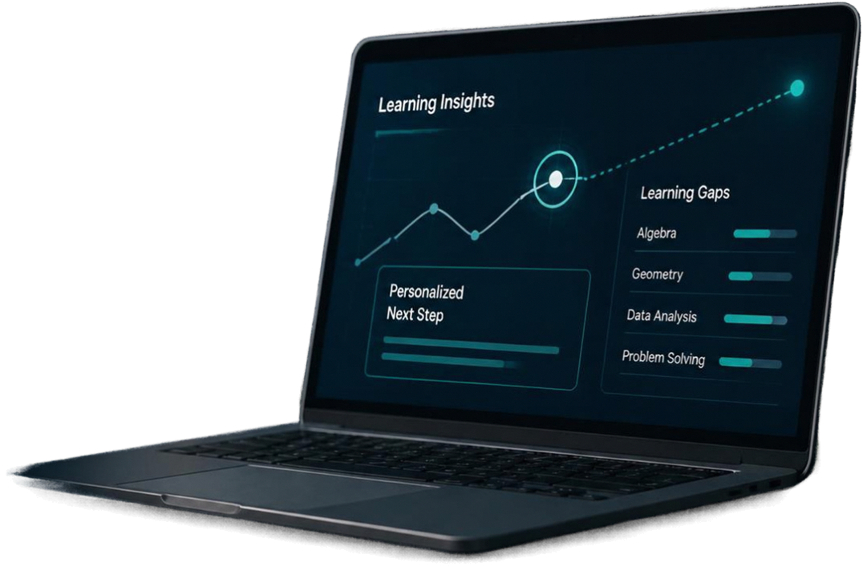


HackMysore 1.0 —
Personalized Learning Platform
A focused MVP for detecting learning gaps and guiding the next step

Slide 2


Students progress at different paces;
learning gaps are hidden
General lesson or score may not reveal the exact concept causing difficulty
Facilitators need clear signals to know when and where to intervene

Slide 3
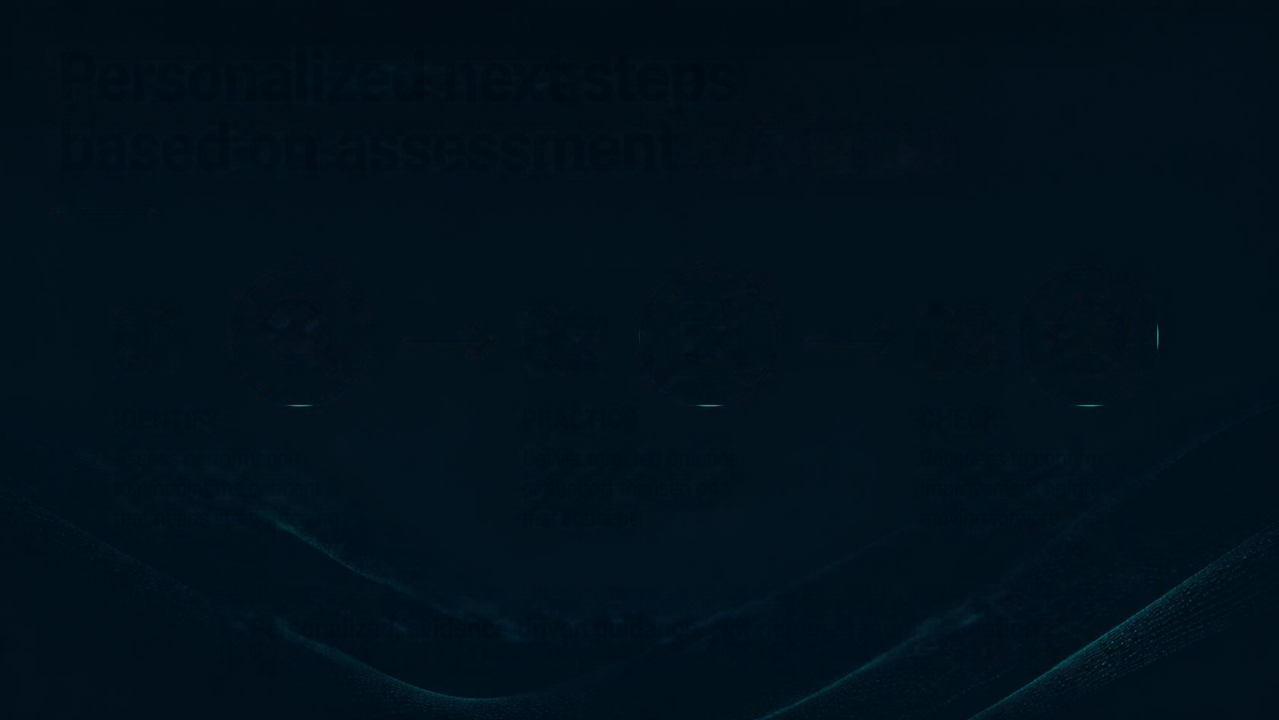







Personalized next steps based on assessment evidence
01
02
03
IDENTIFY
PRACTICE
CHECK
Assess performance
to pinpoint the concept
that needs strengthening
Deliver targeted practice
or support focused on
that concept
Reassess to confirm
improvement before
moving forward
Personalized, evidence-driven guidance. Not generic recommendations.

Slide 4













The Adaptive Learning Loop
01
Measure
Student answers questions to gather data
06
Adapt
02
Detect
System updates progress and plans next steps
System identifies patterns of struggle
05
Reassess
03
Understand
Student attempts focused assessment again
Pinpoint the specific weak concept
04
Intervene
Provide targeted practice or teacher support

Slide 5
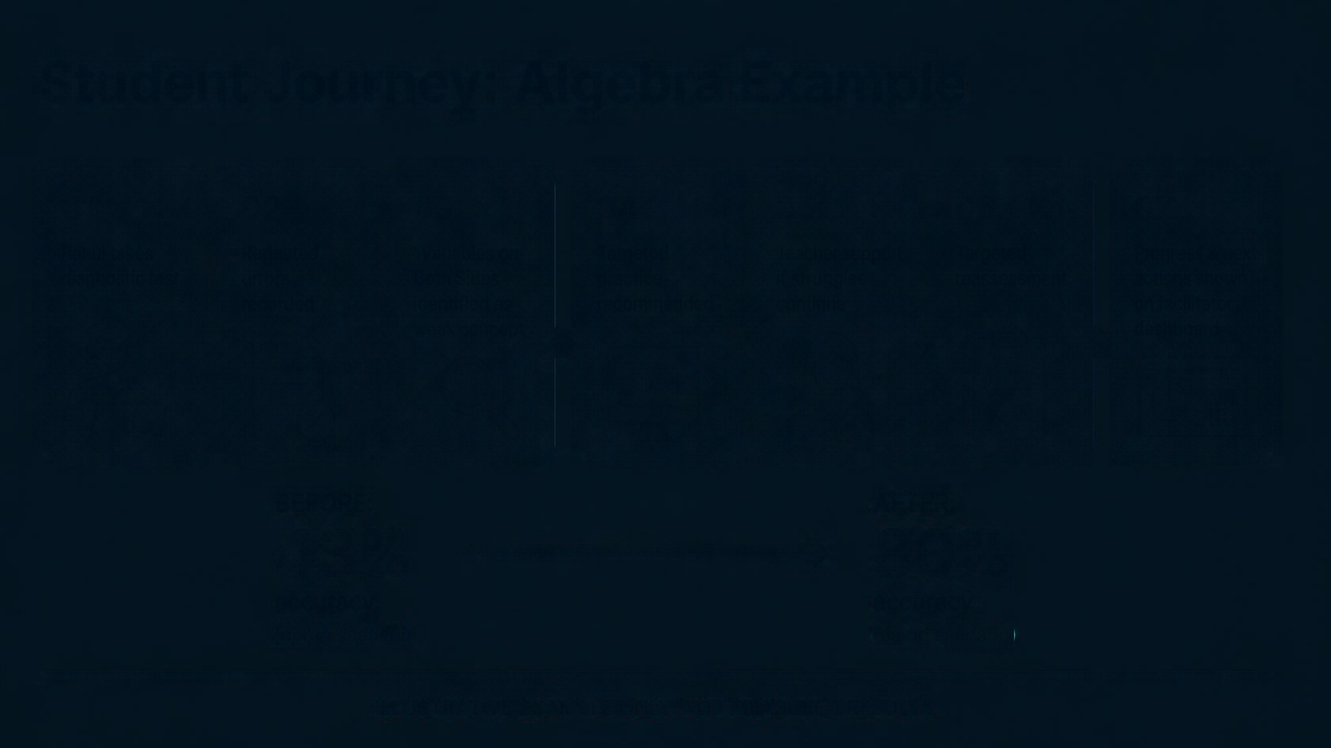





















Student Journey: Algebra Example
01
02
03
04
05
06
07
Rahul takes diagnostic test
Repeated errors recorded
“Variables on Both Sides” identified as weak concept
Target practice recommended
Teacher support if struggles continue
Target reassessment
Progress & next actions shown on facilitator dashboard
BEFORE:
AFTER:
43%
80%
accuracy
accuracy
(demo scenario)
(demo scenario)
ILLUSTRATIVE EXAMPLE ONLY. NOT MEASURED RESULTS.

Slide 6
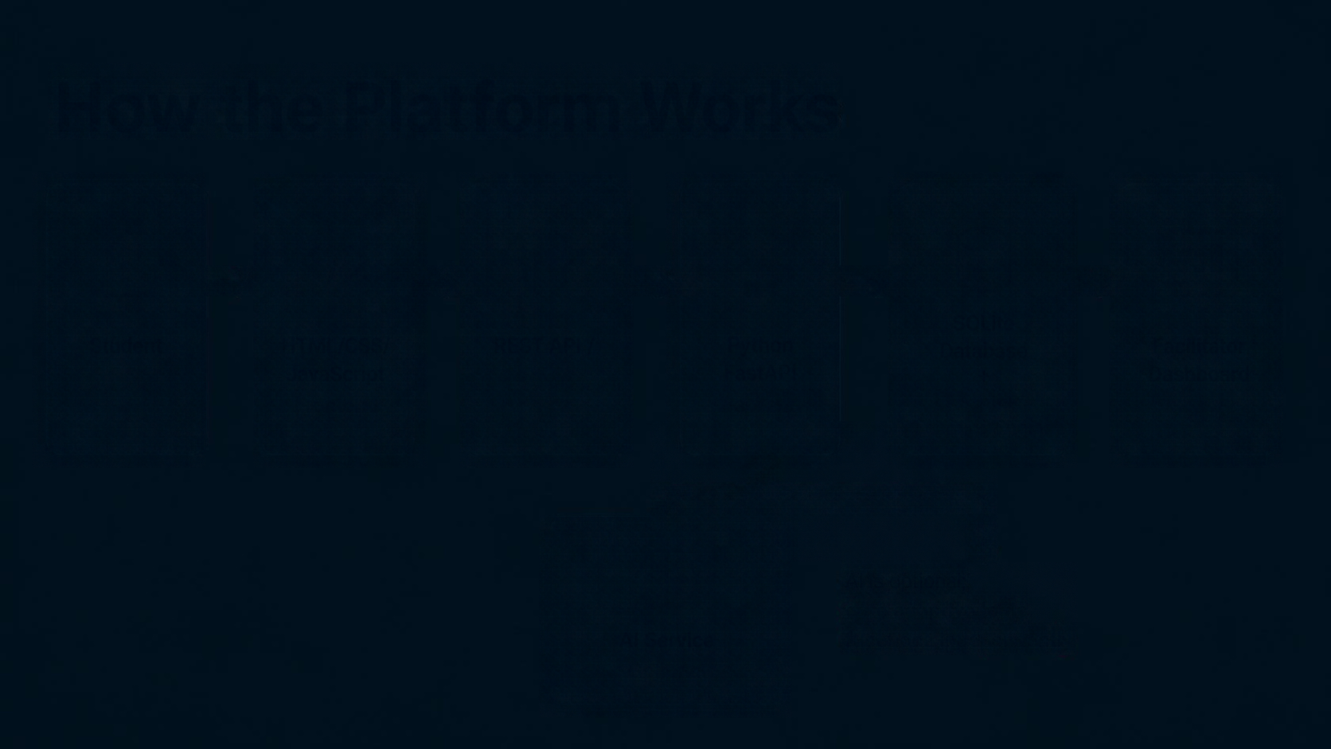

















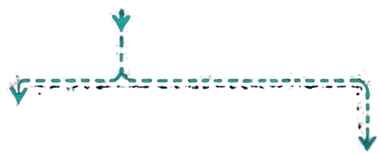


How the Platform Works
SQLite
Database
+
Student
REST API / JSON
Python
FastAPI
Facilitator Dashboard
HTML/CSS/JavaScript
Frontend
Backend
Adaptive Learning Engine
AI is optional;
core adaptive logic functions independently
AI Service
Optional

Slide 7










Hackathon
MVP Scope
Local setup on a single machine
Mathematics assessment focused on Algebra
Saved attempts and struggle detection
Identification of weak concepts
Targeted intervention and reassessment
Updated progress tracking
Facilitator insights dashboard
Prioritizes reliable end-to-end
adaptive learning loop over broad features

Slide 8



Future Scope
(Optional Enhancements)
More subjects and grade levels
Advanced analytics and resource providers
Parent notifications via Telegram
Stronger authentication and teacher verification
Production deployment
Based on actual performance, identify what a student is struggling with and change what happens next.

